Slide 1
Discrete Mathematics
Dr. Han Huang
South China University of Technology

Slide 2
Chapter 5. Relations
Representing Relations
Section 5.3

Slide 3
Contents
1
Representing Relations Using Matrices
2
Representing Relations Using Digraphs

Slide 4
Representing Relations Using Matrices

Slide 5
§5.3: Representing Relations
Before saying more about the n-th power of a relation, let’s talk about representations
Some ways to represent n-ary relations:
  With a list of n-tuples.
  With a function from the (n-ary) domain to {T,F}.
Special ways to represent binary relations:
  With a zero-one matrix.
  With a directed graph.

Slide 6
Why bother with alternative representations? Is one not enough?
One reason: some calculations are easier using one representation, some things are easier using another
There are even some basic ideas that are suggested by a particular representation
It’s often worth playing around with different representations!

Slide 7
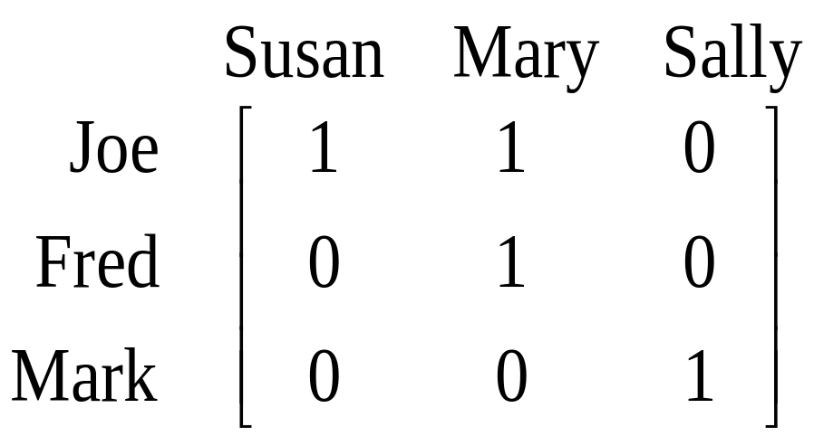
Using Zero-One Matrices
To represent a binary relation R:A×B by an |A|×|B| 0-1 matrix M_{R} = [m_{ij}], let m_{ij} = 1 iff (a_{i},b_{j})∈R.
E.g., Suppose Joe likes Susan and Mary, Fred likes Mary, and Mark likes Sally.
Then the 0-1 matrix
representation
of the relation
Likes:Boys×Girls
relation is:

Slide 8
Special case 1-0 matrices for a relation
on A (that is, R:A×A)
Convention: rows and columns list elements in the same order
This where 1-0 matrices come into their own!

Slide 9
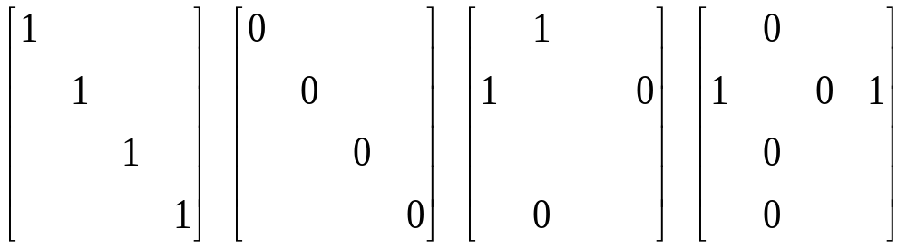
Zero-One Reflexive, Symmetric
Recall: Reflexive, irreflexive,
symmetric, and asymmetric relations.
  These relation characteristics are very easy to recognize by inspection of the zero-one matrix.
any-
thing
any-
thing
anything
anything
any-
thing
any-
thing

Slide 10
Zero-One Reflexive, Symmetric
Recall: Reflexive, irreflexive,
symmetric, and asymmetric relations.
  These relation characteristics are very easy to recognize by inspection of the zero-one matrix.
any-
thing
any-
thing
anything
anything
any-
thing
any-
thing
Reflexive:
only 1’s on diagonal
Irreflexive:
only 0’s on diagonal
Symmetric:
all identical
across diagonal
Asymmetric:
all 1’s are across
from 0’s

Slide 11
Representing Relations Using Digraphs

Slide 12
Definition
A directed graph, or digraph, consist of a set V of vertices ( or nodes ) together with a set E of ordered pairs of elements of V called edges ( or arcs ). The vertex a is called the initial vertex of the edge (a,b), and the vertex b is called the terminal vertex of this edge.

Slide 13
1
2
1
2
4
3
4
3
R1 = { (1,1),(1,3),(2,1),(2,3),(2,4),(3,1),(3,2),(4,1) }
R2 = { (1,3),(1,4),(2,1),(2,2),(2,3),(3,1),(4,1),(4,3) }

Slide 14
Using Directed Graphs
A directed graph or digraph G=(V_{G},E_{G}) is a set V_{G} of vertices (nodes) with a set E_{G}⊆V_{G}×V_{G} of edges (arcs). Visually represented using dots for nodes, and arrows for edges. A relation R:A×B can be represented as a graph G_{R}=(V_{G}=A∪B, E_{G}=R).
Edge set E_{G}
(blue arrows)
Matrix representation M_{R}:
Graph
rep. G_{R}:
Joe
Susan
Fred
Mary
Mark
Sally
Node set V_{G}
(black dots)

Slide 15
Digraph Reflexive, Symmetric
Many properties of a relation are easily determined
by inspection of its graph.












Slide 16
Digraph Reflexive, Symmetric
Many properties of a relation can be determined
by inspection of its graph.











Reflexive:
Every node
has a self-loop
Irreflexive:
No node
links to itself
Symmetric:
Every link is
bidirectional
Asymmetric:
No link is
bidirectional
These are not symmetric & not asymmetric
These are non-reflexive & non-irreflexive

Slide 17
Particularly easy with a graph
Properties that are somehow ‘local’ to a given element, e.g.,
  “does the relation contain any elements that are unconnected to any others?”
Properties that involve combinations of pairs, e.g.,
  “does the relation contain any cycles?”
  things to do with the composition of relations
  (e.g. the n-th power of R)

Slide 18
Boolean Operation

Slide 19
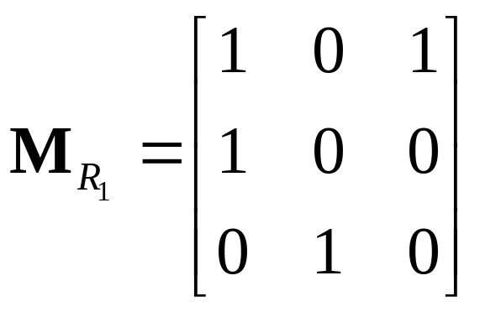
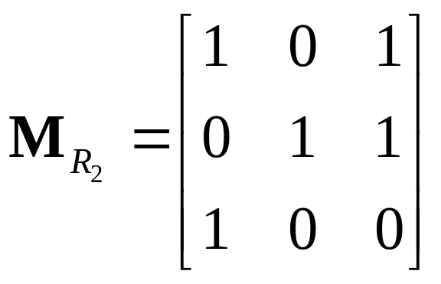
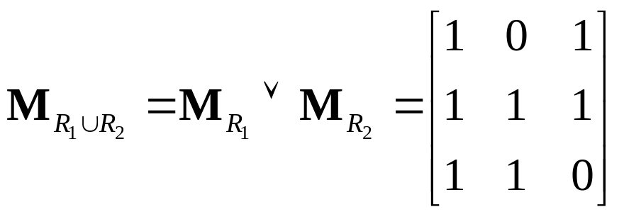
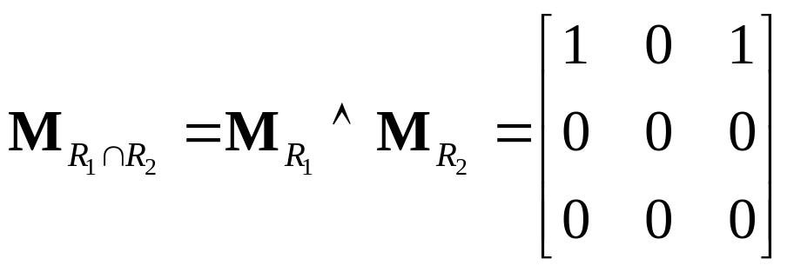
Example 4

Slide 20
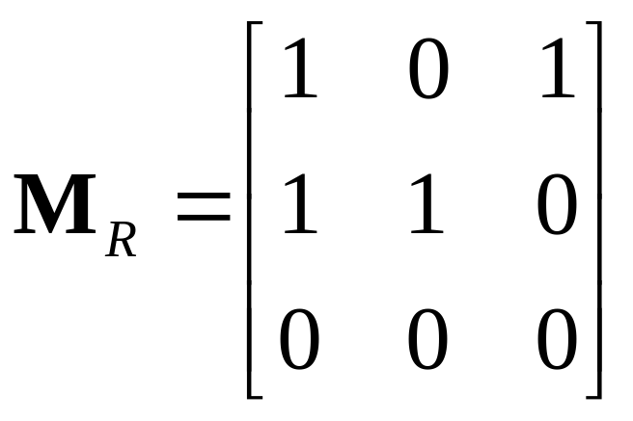
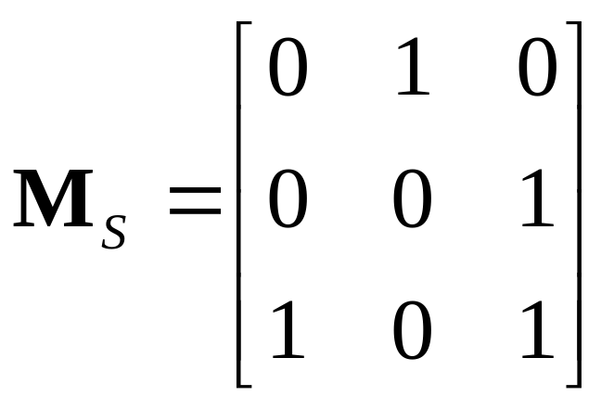
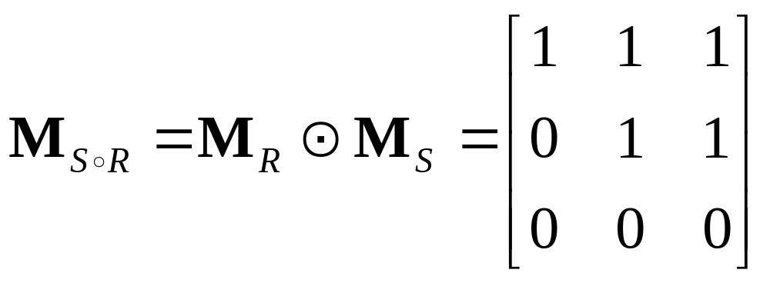
Example 5

Slide 21
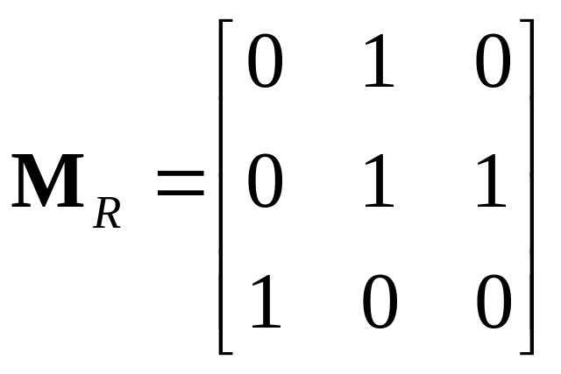
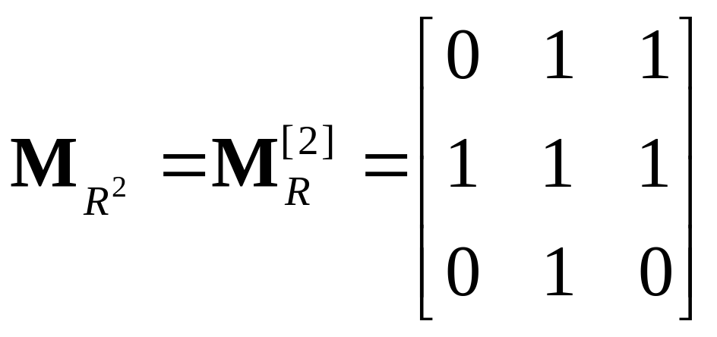
Example 6

Slide 22
Applications

Slide 23
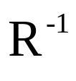

Applications
1.
Find and

Slide 24
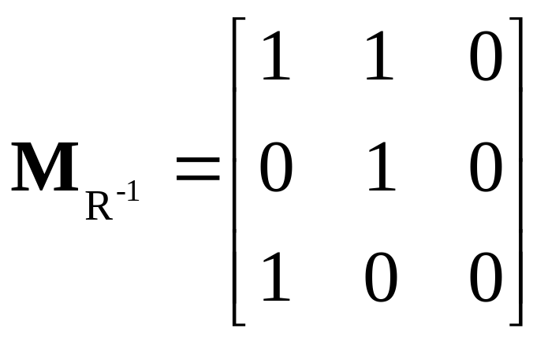
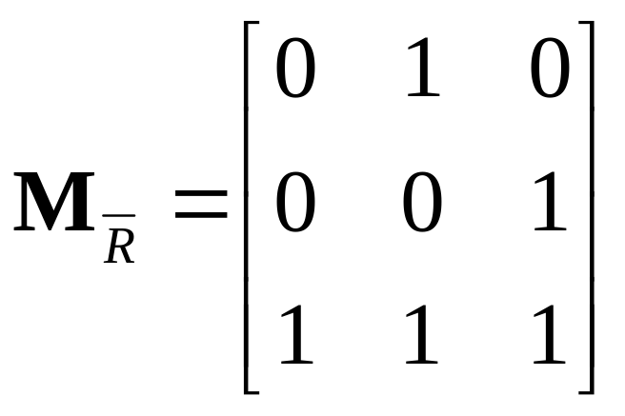
Applications
Solution:

Slide 25


Applications
2.
1
1
2
2
And suppose :
3
3
Please draw the graph of

Slide 26
Applications
Solution:
1
1
1
:
2
2
2
3
3
3

Slide 27
End of Section 5.3
Click to edit company slogan .

